Slide 1







Davies-Bouldin Index
The DB index captures the intuition about clusters that are
well-spaced from each other and
themselves very dense are likely a ‘good’ clustering.
This is because the measure’s ‘max’ statement repeatedly selects the values where the average point is farthest away from its centroid, and where the centroids are closest together. As the DB index shrinks, the clustering is considered ‘better’. The DB Index is calculated by the following formula:
where n is the number of clusters and σi is the average distance of all points in cluster i from the cluster centroid ci.

Slide 2

Dunn Index
The Dunn Index captures the same idea as the DB Index: it gets better when clusters are well-spaced and dense. But the Dunn Index increases as performance improves.
While the DB index considers the dispersion and separation of all clusters, the Dunn Index only considers the worst cases in the clustering: the clusters that are closest together and the single most dispersed cluster.
The Dunn Index is calculated by the following formula:
where i, j and k are each indices for clusters, d measures the inter-cluster distance and d’ measures the intra-cluster difference.

Slide 3

Silhouette Coefficient
The Silhouette Coefficient tells us how well-assigned each individual point is.
If S(i) is close to 0, it is right at the inflection point between two clusters.
If it is closer to -1, then we would have been better off assigning it to the other cluster.
If S(i) is close to 1, then the point is well-assigned and can be interpreted as belonging to an ‘appropriate’ cluster.
The Silhouette Coefficient is calculated by the following formula:
where a(i) is the average distance of point i from all other points in its cluster and b(i) is the smallest average distance of i to all points in any other cluster.

Slide 4
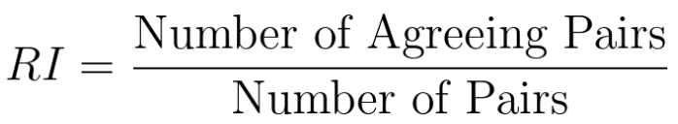
Rand Index
It computes a similarity measure between two clusters by considering all pairs of samples and counting pairs that are assigned in the same or different clusters in the predicted and true clustering.
The Rand Index is calculated by the following formula:
The RI can range from zero to 1, a perfect match.
Drawback of Rand Index is that it assumes that we can find the ground-truth clusters labels and use them to compare the performance of our model, so it is much less useful than the Silhouette Score for pure Unsupervised Learning tasks.

Slide 5
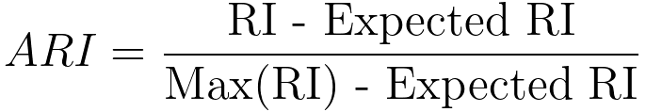
Adjusted Rand Index
The Rand Index computes a similarity measure between two clustering by considering all pairs of samples and counting pairs that are assigned in the same or different clusters in the predicted and true clustering.
The raw RI score is then “adjusted for chance” into the ARI score using the following scheme:
The Adjusted Rand Index, similarly, to RI, ranges from zero to one, with zero equating to random labelling and one when the clusters are identical.

Slide 6
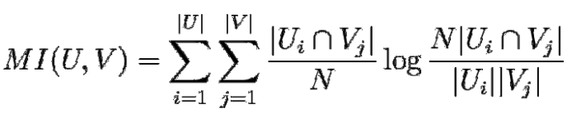
Mutual Information
It is a measure of the similarity between two labels of the same data.
Mutual Information between clusters U and V is given as:
Similarly, to Rand Index, one of the major drawbacks of this metric is requiring to know the ground truth labels a priori for the distribution. Something which is almost never true in real-life scenarios with Clustering.

Slide 7
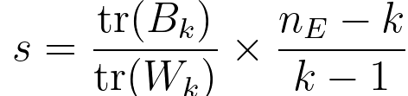
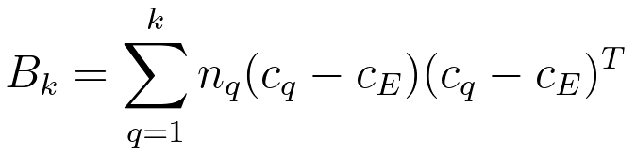
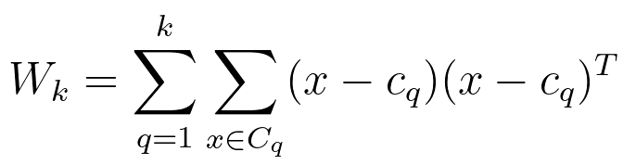
Calinski-Harabasz Index
Calinski-Harabasz Index is also known as the Variance Ratio Criterion.
The score is defined as the ratio between the within-cluster dispersion and the between-cluster dispersion. The C-H Index is a great way to evaluate the performance of a Clustering algorithm as it does not require information on the ground truth labels.
The C-H index is defined as
and
where tr(Bk) is trace of the between group dispersion matrix
The higher the Index, the better the performance.

Slide 8

Sum of Squared Errors Within Cluster (SSW)
It is measured within a cluster (an intra-cluster metric), whereas separation is measured between clusters (an inter-cluster measure).
The SSW or SSE(W) is defined as
SSW=
where x is an example in the cluster, ci is a cluster representative (e.g., its centroid) and mi is the number of examples in the cluster Ci
.
When using the SSW metric, small values indicate a good cluster quality.

Slide 9

Between Group Sum Of Squares (SSB)
We can maximize the distance between clusters using a separation metric. This approach leads to the between group sum of squares (SSB).
The SSB is defined as
where ci is the mean of the ith cluster and c is the overall mean.
Unlike the SSW metric, a good cluster quality is given by the high SSB values.

Slide 10

Purity
Purity evaluates whether each cluster contains only examples from the same class.
The purity (U) is defined as
In the expressions above, pi = ni/n, pj = nj/n, and pij = nij/n, where nij is the number of examples belonging to the class i found in the cluster j and ni (nj ) is the number of examples in the cluster i (j).

Slide 11
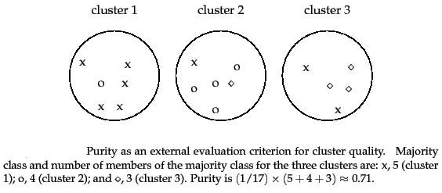



























Purity

Slide 12
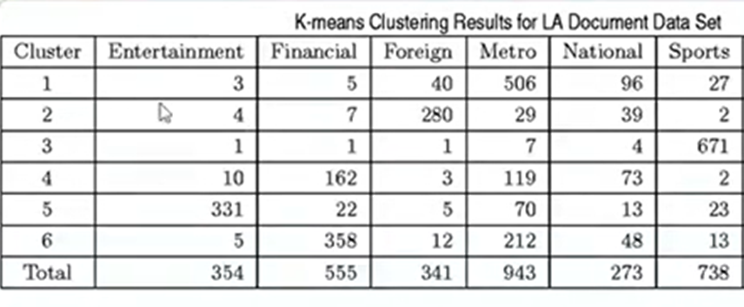


Purity

Slide 13
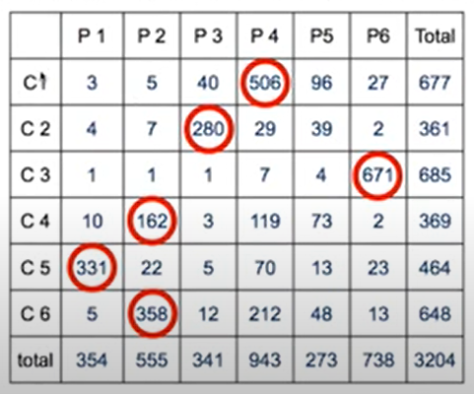













Purity

Slide 14
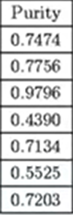


















Purity

Slide 15






Other evaluation metrics
Xie-Beni score
The Ball-Hall index
The Hartigan index
The Xu coefficient
Cophenetic Correlation Coefficient (CPCC)
Hubert Statistic or e Hubert statistical coefficient
The Folkes and Mallows coefficient
Entropy

Slide 16

Thank you

